Slide 1
Smart Traffic Management Simulation Using Predictive Collision Avoidance Algorithm (FCW)
Done by : ayan kar 10200121025
Swayangdipta dey 10200121028
Ankan mondal 10200121035
Jakirul sk. 10200122010

Slide 2
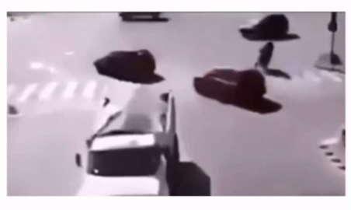
Objective
Develop a simulation model for smart traffic management.
Focus on collision avoidance using a predictive algorithm.

Slide 3
Introduction
Urban traffic requires smart management for safety.
Traditional systems have delayed response mechanisms.
Project simulates real-time FCW-based collision avoidance.
Uses wireless communication and real-world mapping.

Slide 4
Project Objectives
Smart traffic simulation with collision detection.
Propose and evaluate a predictive avoidance algorithm.
Use real map data (Kalyani).
Simulate wireless vehicle communication.

Slide 5
Work Completed
Proposed FCW algorithm for predictive warning.
Analyzed existing algorithms and limitations.
Implemented alarm system for collision identification.
Simulated wireless V2V communication module.
Mapped real location (Kalyani).
Created SUMO config file for traffic simulation.

Slide 6
Work in Progress / To Be Done
Integrate dynamic collision variables into simulation.
Implement FCW algorithm in simulation.
Analyze advantages and define future scope.

Slide 7
Expected Outcomes
Effective collision prediction and avoidance.
Enhanced traffic safety via early warnings.
Base for future smart city traffic systems.

Slide 8
THANK
YOU

